Slide 1
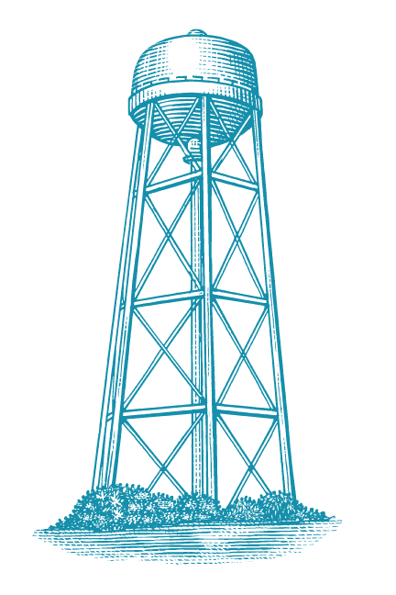
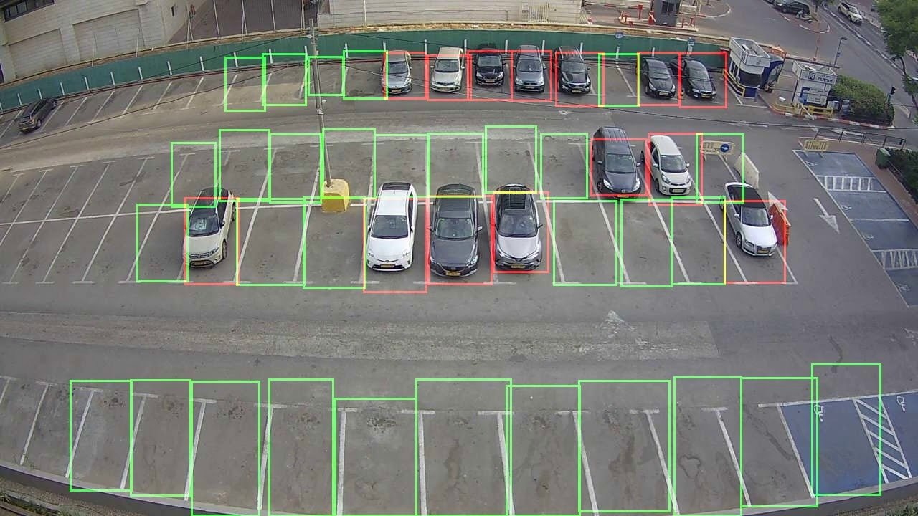

Parking Space Detection
By Athul Krishna Sughosh, Brian Dao, Rohan Kolappa

Slide 2

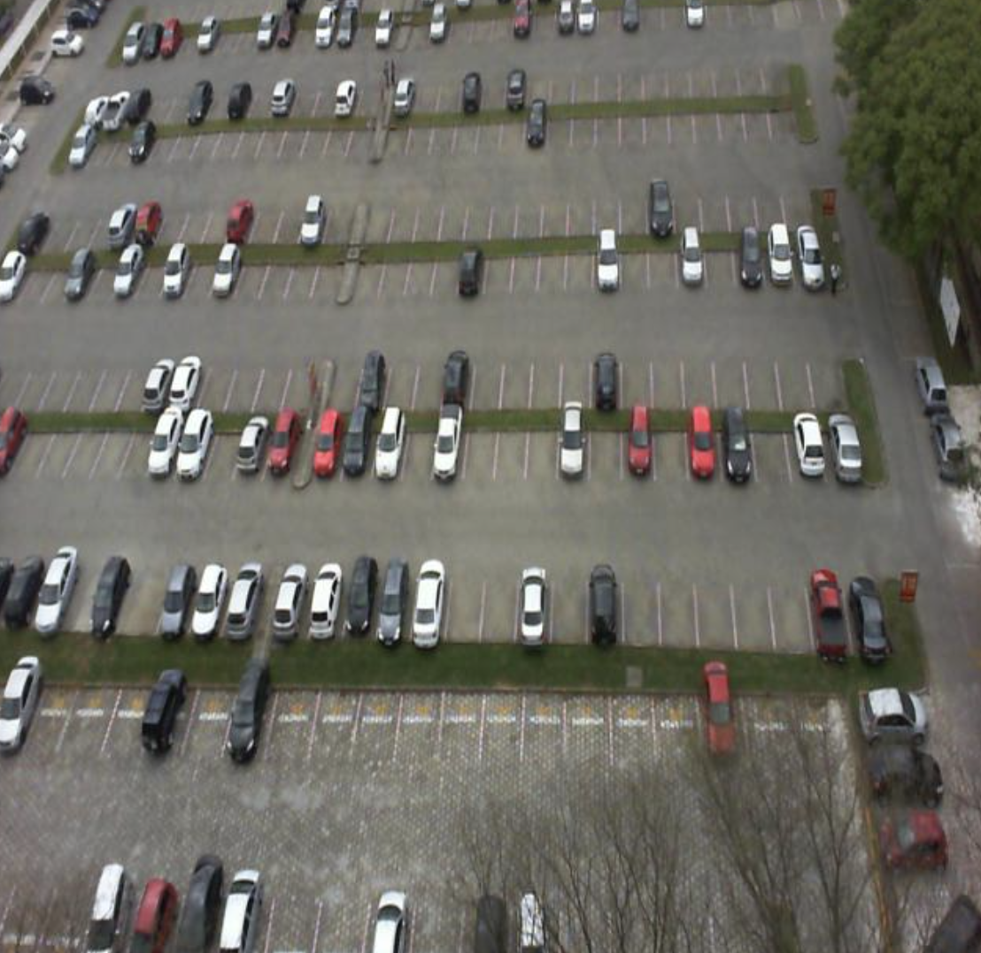
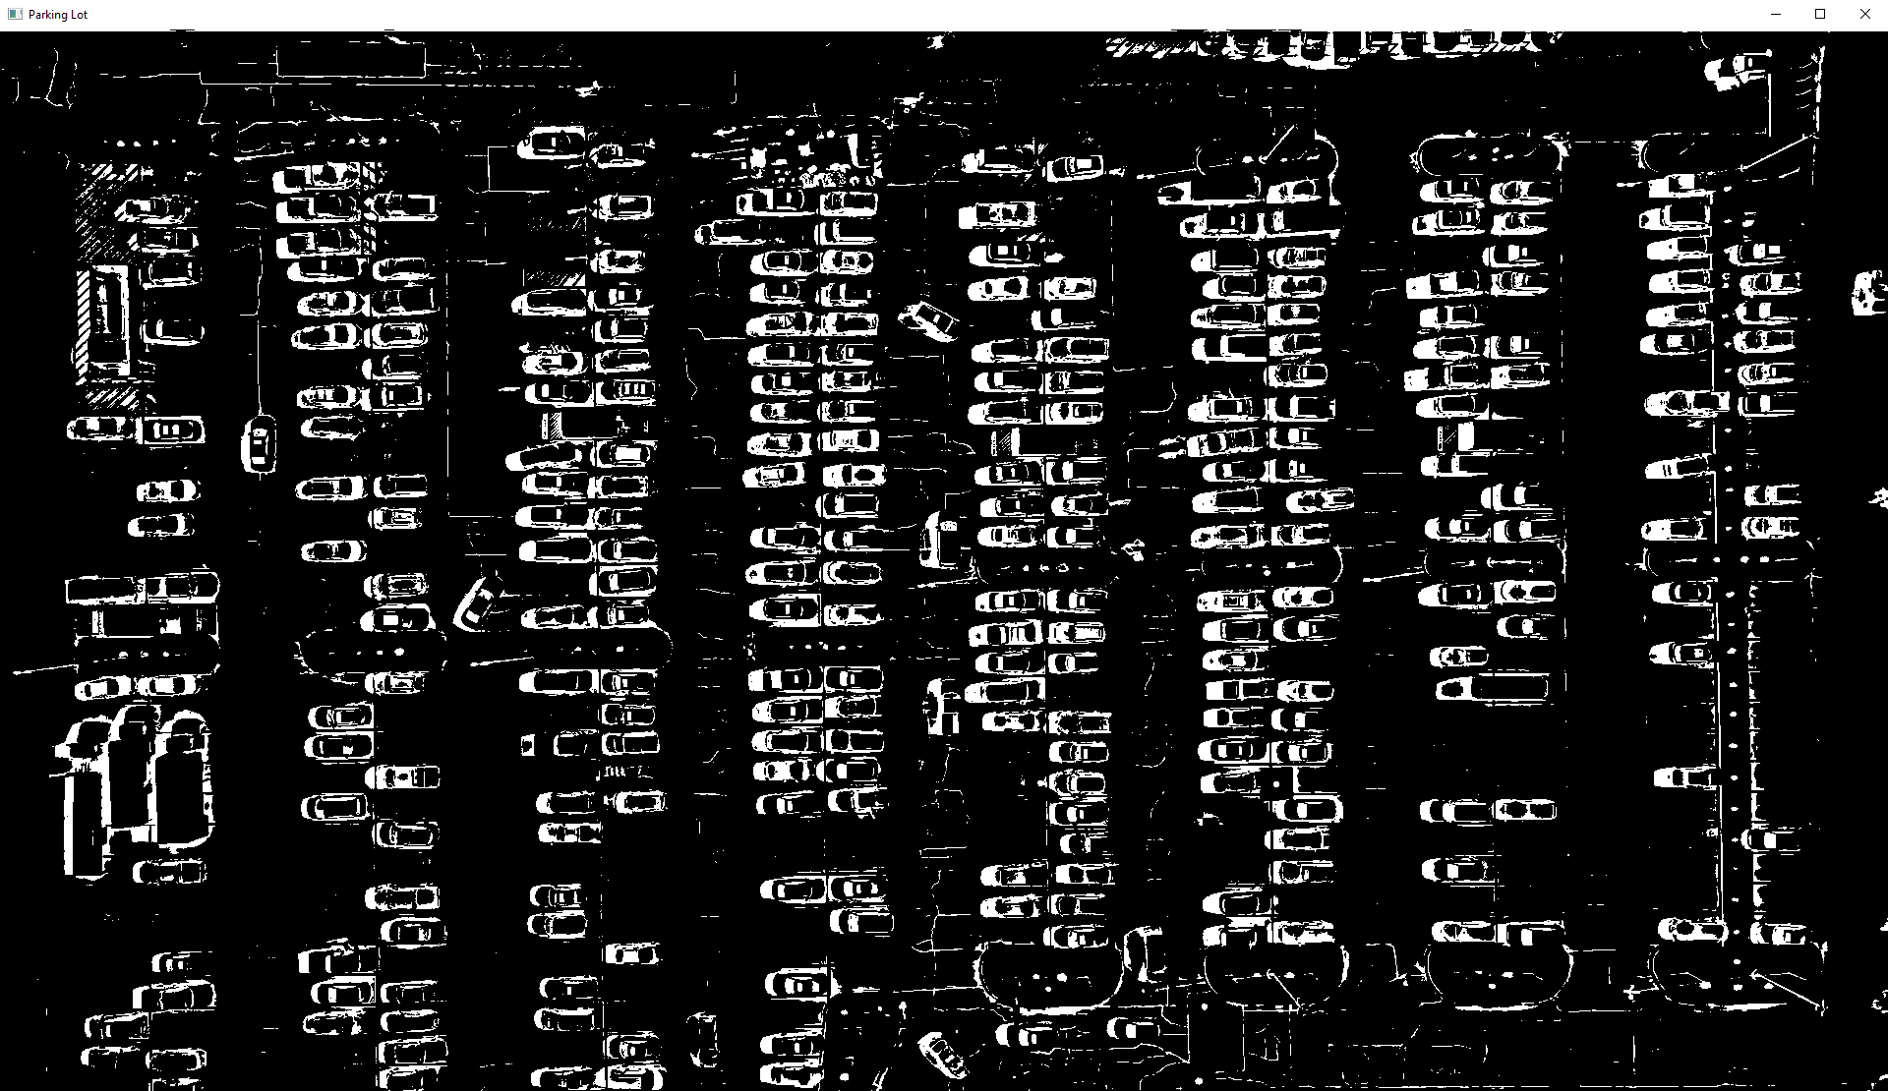
Project Overview
This project explores both traditional computer vision techniques and machine learning models to develop a parking space detection system.
The primary objective is to accurately classify the availability of parking spaces in real-time from video footage.
Approach 1: Convolutional Neural Networks (CNN):
Trained on an augmented dataset of parking space images.
Classifies spaces as occupied or vacant.
Found inefficient due to prediction time, especially for larger lots.
Approach 2: Traditional Computer Vision Techniques:
Utilizes OpenCV for image processing, including adaptive thresholding and white pixel counting within predefined bounding boxes.
Chosen for its efficiency in real-time detection.

Slide 3

Problem Statement and Objectives
Efficient Parking Management Needs:
Urban Challenge:
High demand for parking in urban areas leads to congestion and frustration.
Existing hardware-based systems are expensive, require regular maintenance, and can be inaccurate.
Project Goals:
Low-Cost Solution:
Develop an affordable and accessible parking management system.
Robust System:
Ensure reliability and accuracy in various conditions (e.g., different lighting, weather).
Improved Management:
Optimize the use of available parking spaces.
Reduce the time drivers spend looking for parking.
Environmental Impact:
Decrease emissions by reducing the time vehicles spend idling and circling for parking.
User Experience:
Enhance the overall user experience by providing real-time availability information.

Slide 4

Dataset Description
PKLot Dataset:
Description:
Contains 12,416 images of parking lots extracted from surveillance camera frames.
Images are annotated with bounding boxes indicating whether the parking spot is occupied or not.
Usage:
Used for training, validation, and testing of the CNN model.
Custom Parking Dataset:
Creation:
Created using a live video feed (1920 x 1080 bird’s eye view) of a parking lot.
Custom dataset generated by cropping 69 x 30 images of occupied and vacant spots.
Details:
Contains 1,605 images of occupied parking spaces.
Contains 400 images of vacant parking spaces.
Purpose:
Used to supplement the PKLot dataset for training the CNN.

Slide 5
Methodology
Machine Learning Approach (CNN):
PKLot Dataset Preprocessing:
Auto-orientation of pixel data (EXIF-orientation stripping).
Resize images to 640x640 (Stretch).
Model Architecture:
2 Convolution Layers using ReLU activation.
2 Pooling Layers.
2 Fully Connected Layers and an output layer.
Hyperparameters:
Epochs: 10
Batch Size: 10
Optimizer: Adam
Loss: Categorical Cross Entropy
Metrics: Accuracy
Training:
Model trained on cropped images using annotated bounding box dimensions.

Slide 6
Methodology
Custom Parking Dataset:
Data Preprocessing and Augmentation:
Normalization, horizontal flipping, shear transformation, random zooming.
20% of the dataset set aside for validation.
Model Architecture:
3 Convolutional layers using ReLU activation.
2 Max Pooling layers.
1 Flatten layer.
1 Dense layer using ReLU.
1 50% Dropout layer.
1 Output dense layer with a single neuron using sigmoid activation.
Hyperparameters:
Epochs: 50
Batch Size: 32
Optimizer: Adam
Loss: Binary Cross Entropy
Metrics: Accuracy

Slide 7
Methodology
Traditional Computer Vision Approach:
Preprocessing:
Convert frames to grayscale.
Apply adaptive thresholding to segment the parking lot into binary regions.
Adaptive Threshold Hyperparameters:
Adaptive Method: Gaussian
Block Size: 53
C: 30
Threshold Type: Binary Inverse
Occupancy Detection:
Calculate the number of white pixels in predefined bounding boxes.
Classify spaces as occupied if there are more than 250 white pixels.

Slide 8
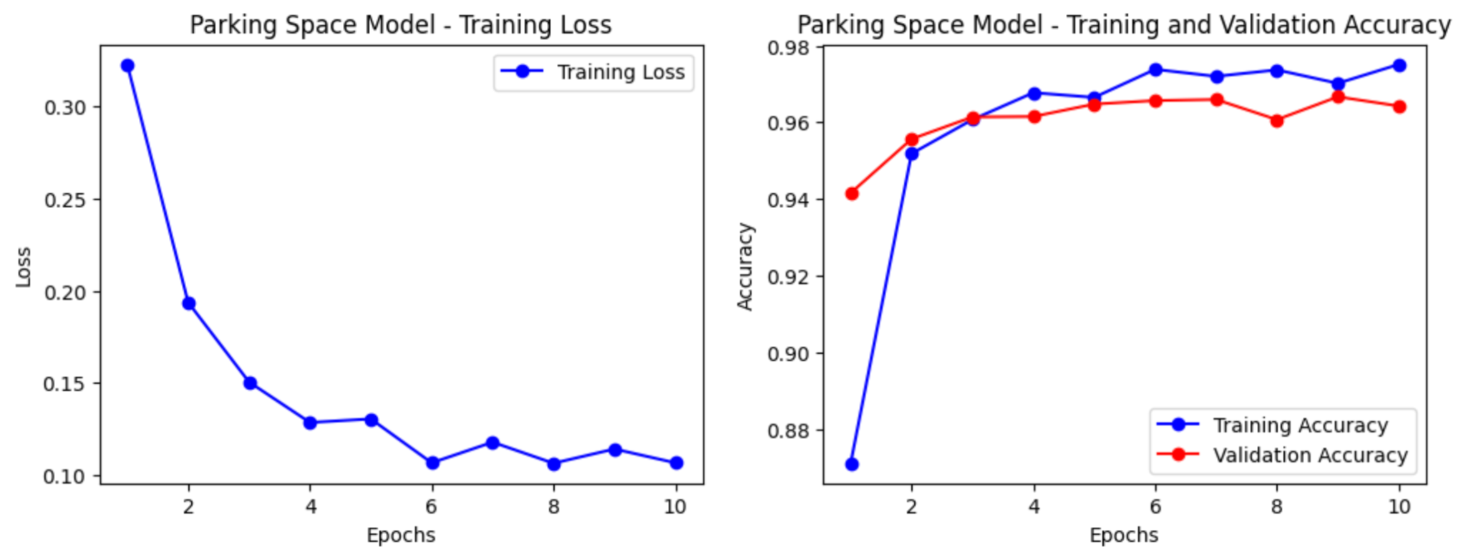
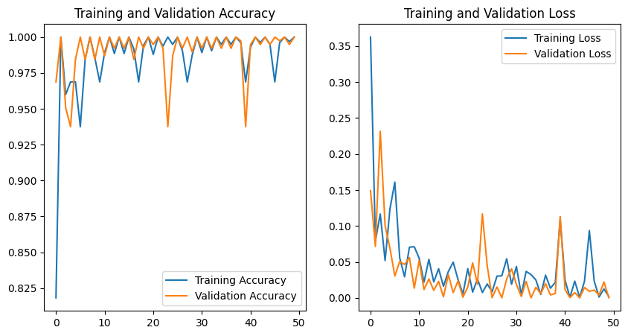
Experimental Results
Performance Metrics:
PKLot Dataset:
Test Accuracy: 99.84%
Custom Cropped Parking Dataset:
Test Accuracy: 99.74%
Efficiency:
CNN Approach:
High accuracy in classifying parking space occupancy.
Impractical prediction time for larger parking lots (approx. 25 milliseconds per space).
Total detection time for 384 spaces is approximately 9.6 seconds.
Traditional Computer Vision Approach:
Real-time performance.
Accurate occupancy detection of the whole lot every frame.
Suitable for large parking lots due to lower computational load.
Occupancy detection performed every 4-5 sec to reduce computational load.
Decision to Use Traditional Method:
Advantages:
Faster detection times suitable for real-time application.
Effective under various conditions (e.g., lighting variations, occlusions).

Slide 9
Conclusion
Project Outcome:
Despite the CNN's high accuracy, its prediction time per space was impractical for larger parking lots.
The traditional computer vision approach was chosen for its efficiency and real-time performance.
This method reliably detected parking occupancy under various conditions, providing an effective solution for automated parking management.
Future Work:
Incorporate more diverse datasets.
Enhance model robustness to function under different conditions (e.g., poor video quality, low lighting, longer videos).
Project Significance:
Addresses current inefficiencies in parking management.
Provides a foundation for future research and development in smart parking solutions.

Slide 10

References
Datasets:
PKLot Dataset
Parking Dataset
Parking Video
Code Repository:
GitHub: Parking-Space-CV

Slide 11
THANK YOU

